Slide 1
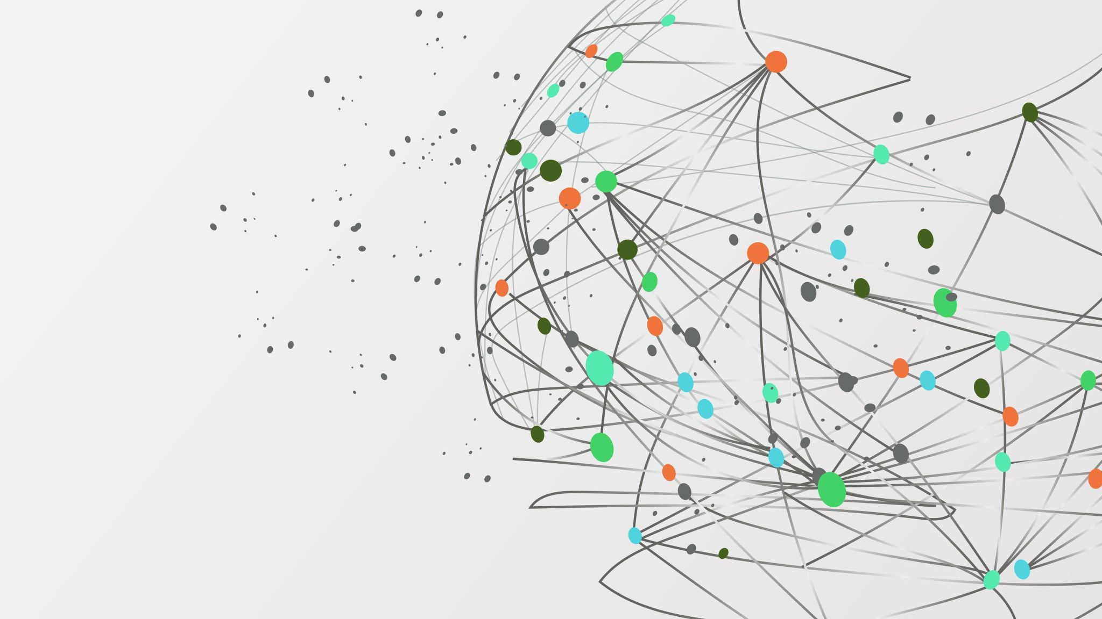
Building Intelligent AI Workflows with LangChain & LangGraph
C R Bhargavi

Slide 2




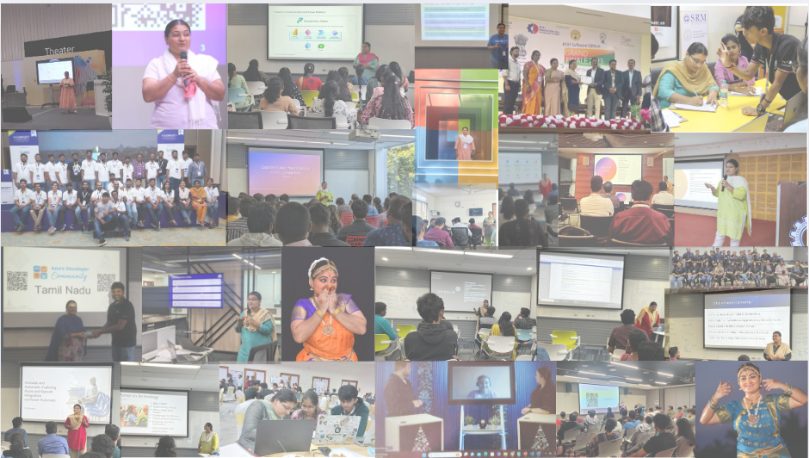


C R Bhargavi
Microsoft MVP |Azure Community Champion | Microsoft MCT
Data Scientist Lead & Power Platform Expert
Global Speaker | Mentor | Blogger | Author
Microsoft Most Valuable Professional & Community Contributor
Passionate about AI, ML, Data Science, Data Engineering and Low-code AI Automations

Slide 3
Session Agenda
What is an AI workflow
Introduction to LangChain
Limitations of linear chains
Introduction to LangGraph
Demo: Intelligent AI workflow
Key takeaways

Slide 4
What is an AI Workflow?
AI workflows connect multiple steps together.
Example:
User Question → Retrieve Data → Call Tool → Generate Answer

Slide 5
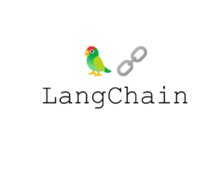
Introduction to LangChain
LangChain is a framework for building applications powered by LLMs.
It provides reusable components for integrating models, prompts, and tools.
It provides tools and abstractions to build complex applications by chaining together different components in a flexible and modular way

Slide 6
Key Components of LangChain
LLM integrations : Model
Prompt templates : Structure prompts dynamically.
Chains : Connect multiple steps into a pipeline.
Tools : External systems like API or search engines
Memory : Maintain conversation context
Retrievers : Fetch relevant data from external knowledge sources

Slide 7
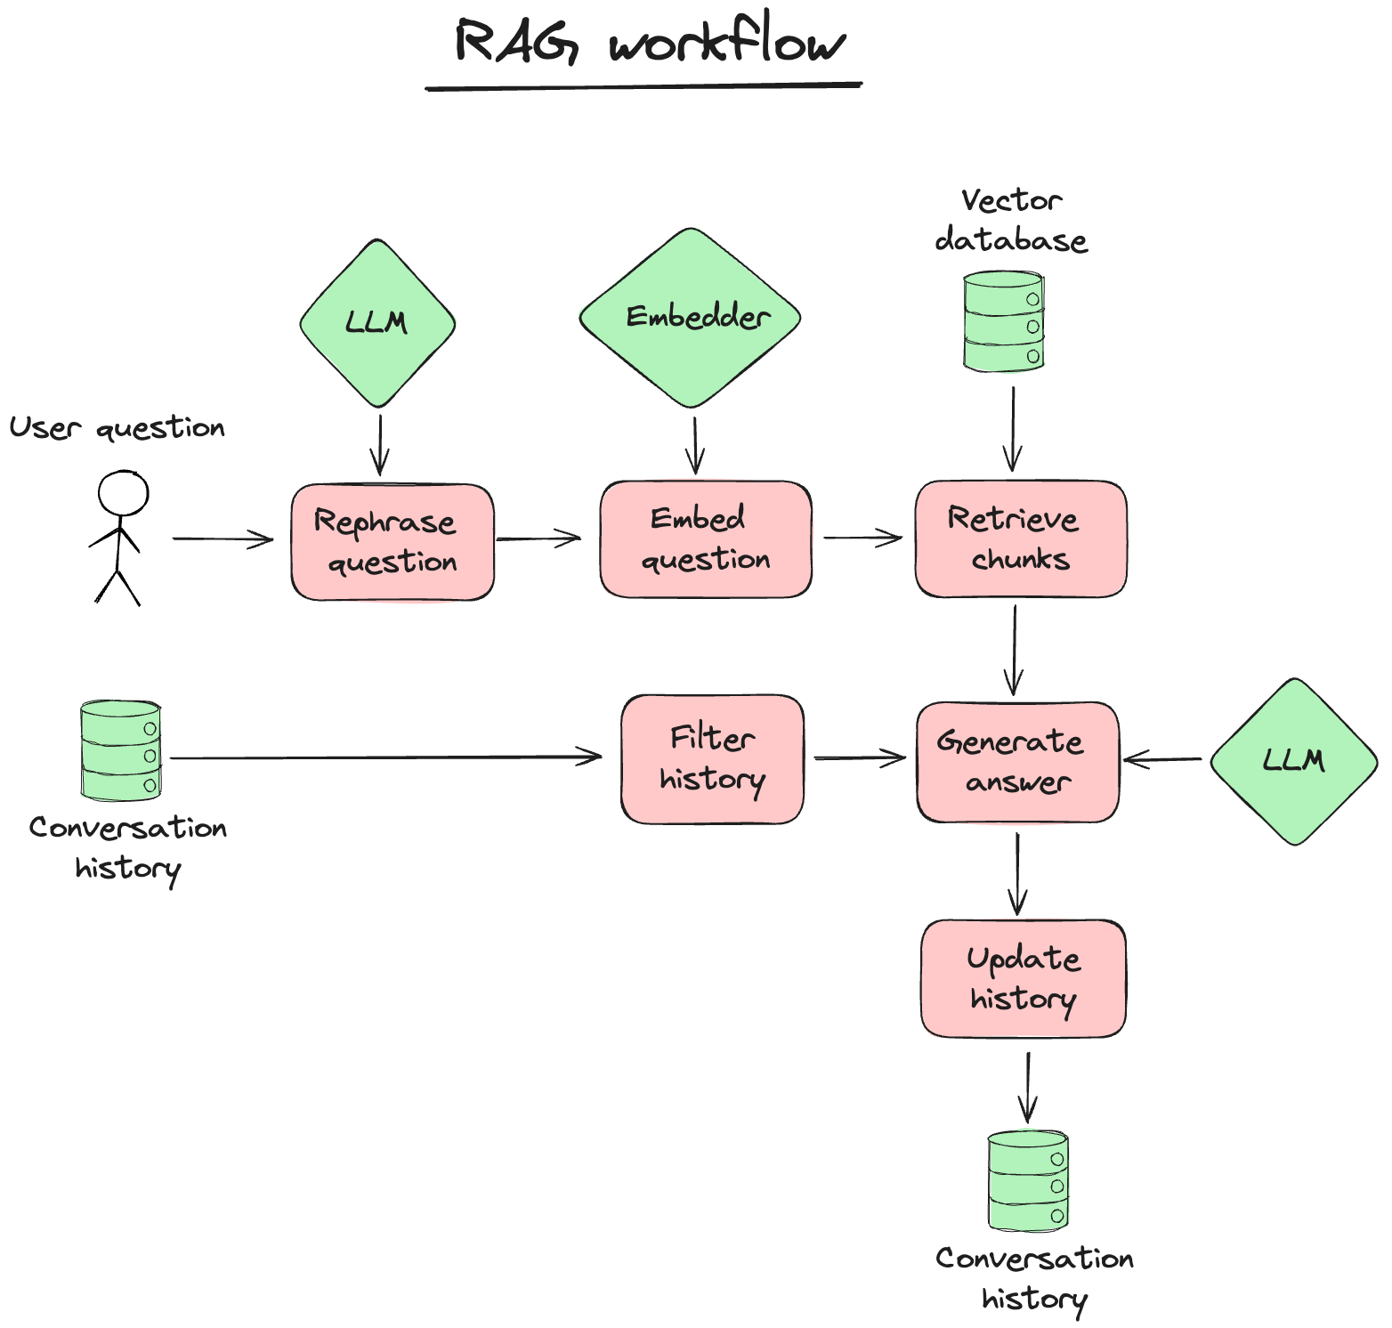
Example LangChain Pipeline
User Query → Retriever → Context → LLM → Response
Used in applications like RAG chatbots and assistants.

Slide 8
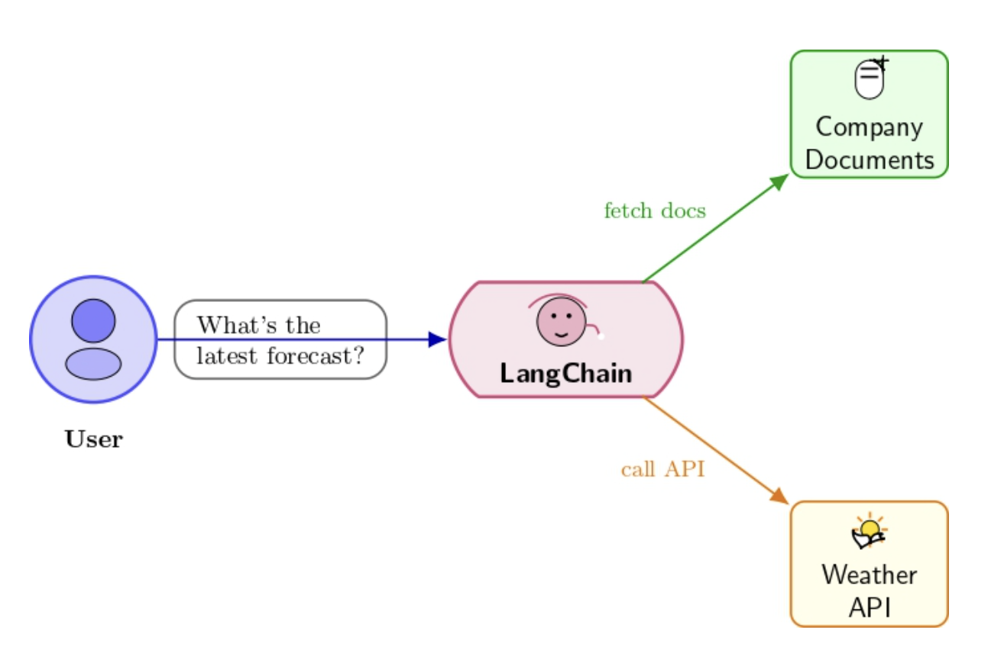
Simple Chains
Create a chain that takes a user's input, processes it with a language model, and performs a specific action based on the output.
Works well for basic tasks like summarization, translation, or text generation
User query -> Language model Process -> Response generation.

Slide 9
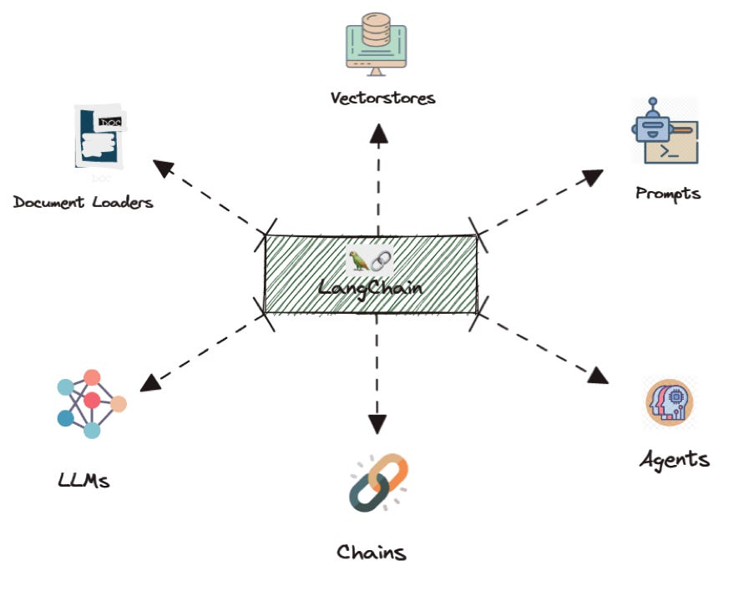
Advanced Chains
Chains can include branching, looping, additional processing step and conditional logic.
User query -> Language model -> Conditional logic -> Different responses.

Slide 10
Limitations of Linear Chains
Linear pipelines follow fixed steps.
Challenges:
• Cannot dynamically decide next actions
• Limited reasoning loops
• Difficult to handle complex tasks

Slide 11
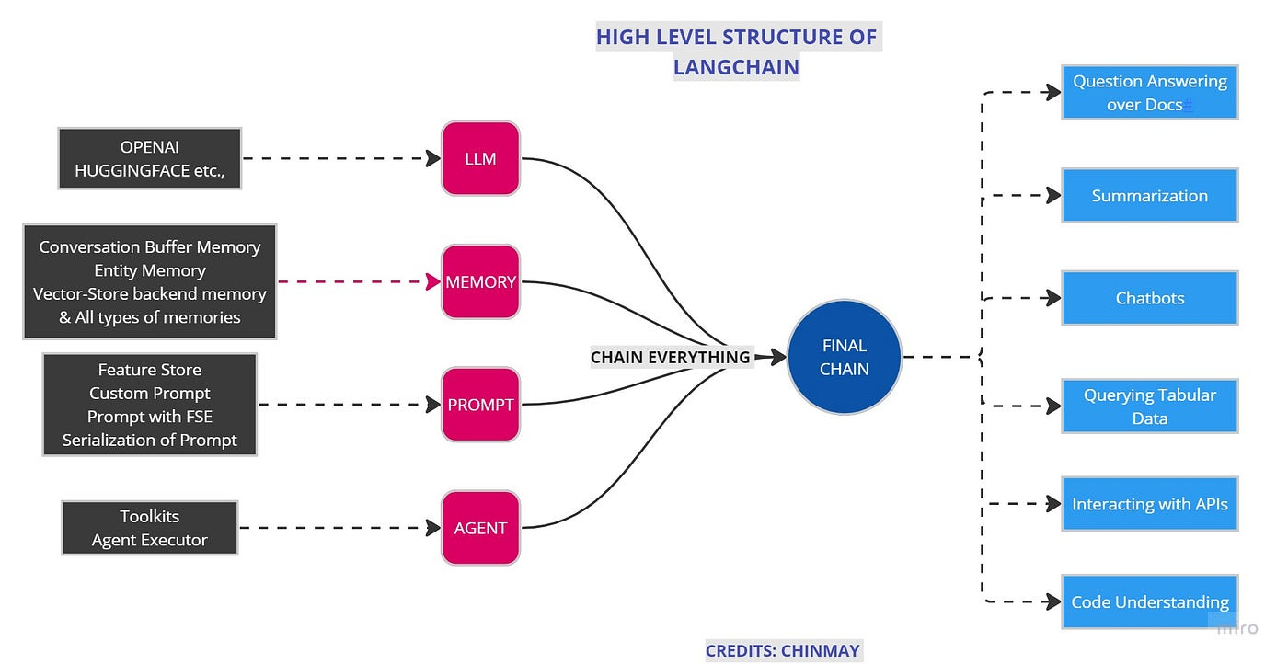

Slide 12
Core Concepts of LangGraph
• Nodes – individual tasks (LLM, tool, retrieval)
• Edges – transitions between tasks
• State – shared context across workflow

Slide 13
Example LangGraph Workflow
User Query → Agent Node → Tool Node → Evaluate Result → Final Response

Slide 14
Demo Architecture
Example: AI Research Assistant
User Query → LangGraph Agent → Search Tool → Summarize Results → Final Answer

Slide 15
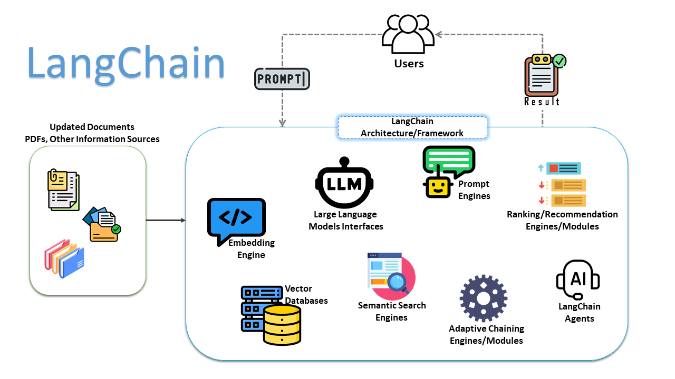

Slide 16
Difference Between LangChain and LangGraph
Capability | LangChain | LangGraph
Prompt management | ✔ | ✔
LLM wrappers | ✔ | ✔
RAG pipelines | ✔ | ✔
Tool calling | ✔ | ✔
Simple chains | ✔ | ✔
Complex workflows | Limited | ✔
Stateful agents | Limited | ✔
Loops / retries | Manual | Built-in

Slide 17
Live Demo
Demo will show:
Agent reasoning
Tool usage
Multi‑step workflow
LCEL (LangChain Expression Language)
All agents implemented with:
LangChain Runnables
Prompt Templates
Output Parsers
Tools

